Slide 1


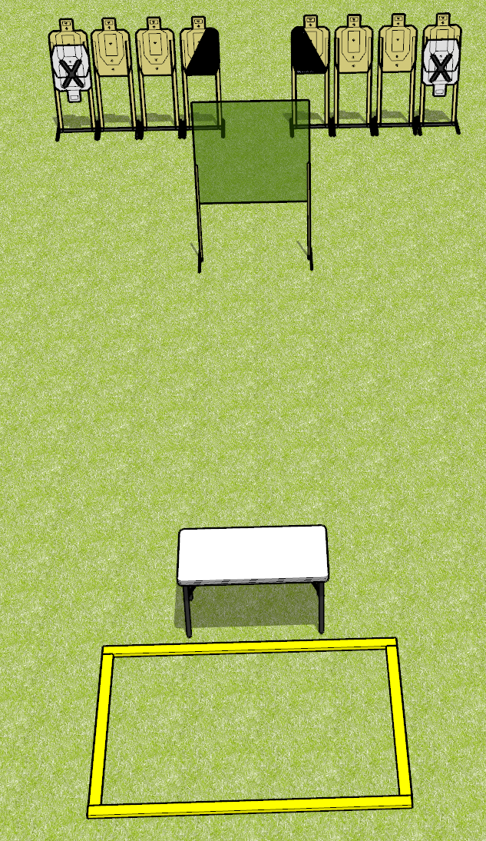
 | Dothan Gun Club – USPSA Match Off the Table Course Designer : Drew Coleman
Round Count 16 rounds 8 USPSA
Equipment List 2 wall feet 2 medium, 2 8’ fault lines 1 left + 1 right diag, 8 targets (6 + 2 NS)

Slide 2
Off the Table
Written Stage Briefing
Off the Table is a 16 round, 80 point, Comstock course of fire. There are 8 USPSA targets. The best 2 hits will score.
Start position is heels touching rear fault lines, wrists below belt. Firearm is on table, trigger guard on mark, unloaded. All magazines to be used on stage start on the table.
On the audible start signal, engage targets as they become available from within the shooting area.

Slide 3
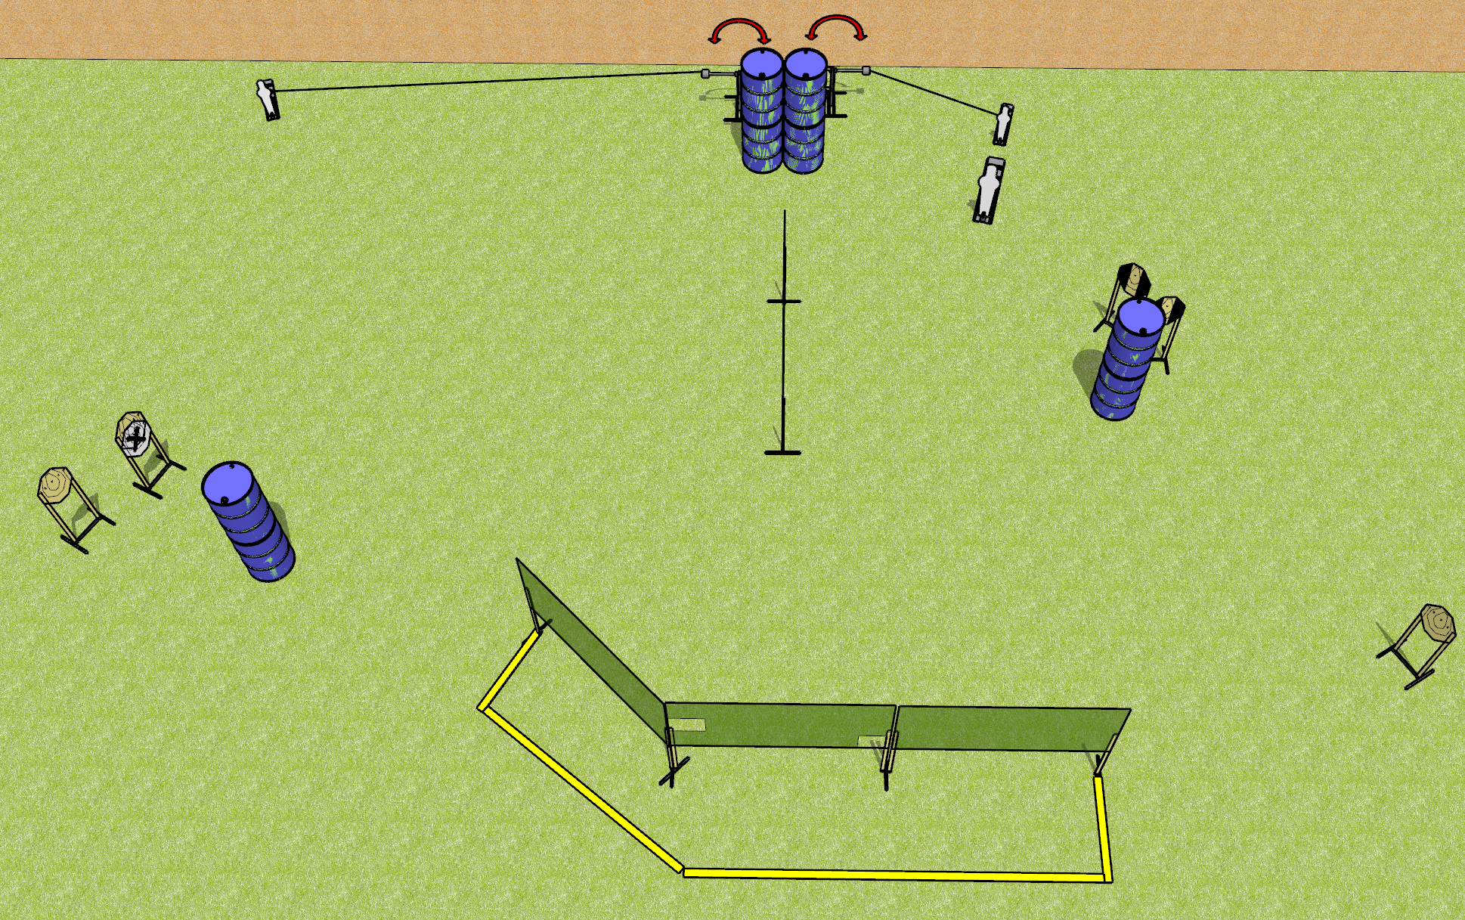
 | Dothan Gun Club – USPSA Match No More Funny Business Course Designer : Drew Coleman
Round Count 17 rounds 7 IPSC 1 PP, 2 MP
Equipment List 7 wall feet 2 swingers + activators 2 tux + 6 targets (5 scoring + 1 NS)

Slide 4
No More Funny Business
Written Stage Briefing
No More Funny Business is a 17 round, 85 point, Comstock course of fire. There are 7 IPSC targets and 3 steel. The best 2 hits on cardboard will score and steel must fall to score.
The swingers are activated by poppers and remain visible at rest.
Handgun start position is hands touching marks. Handgun is loaded and holstered.
PCC start position is muzzle touching either mark, stock on belt. Loaded carbine is held with both hands, safety on.
On the audible start signal, engage targets as they become available from within the shooting area.

Slide 5
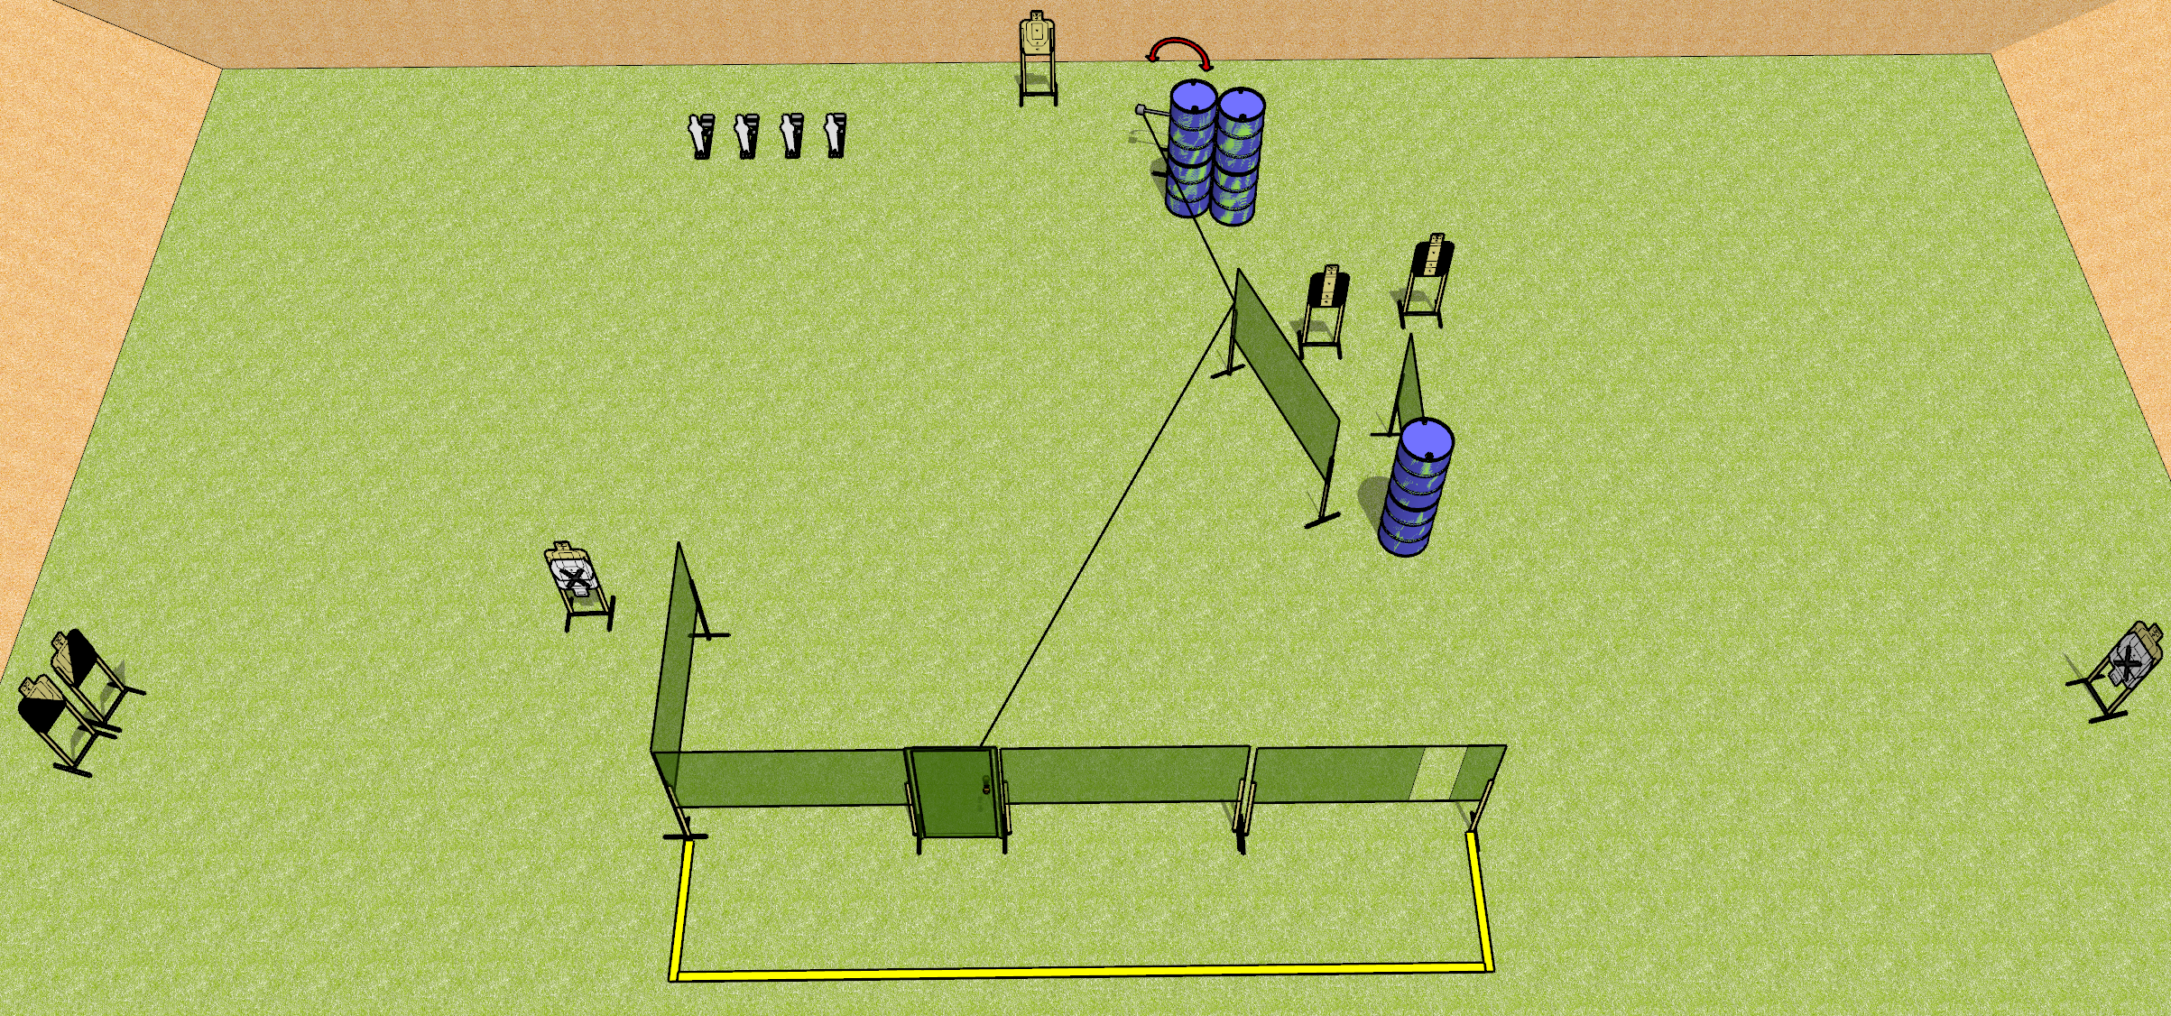
 | Dothan Gun Club – USPSA Match Pain is the Only Way Out Course Designer : Drew Coleman
Round Count 20 rounds 8 USPSA 4 MP
Equipment List 10 wall feet 1 swinger + door + activator 1 left + 1 right diag, 2 tux, 4 targets (3 scoring + 1 NS)

Slide 6
Pain is the Only Way Out
Written Stage Briefing
Pain is the Only Way Out is a 20 round, 100 point, Comstock course of fire. There are 8 USPSA targets and 4 steel. The best 2 hits on cardboard will score and steel must fall to score.
The swinger is activated by opening the door and remains visible at rest.
Handgun start position is both hands touching door handle. Handgun is loaded and holstered.
PCC start position is muzzle touching doorknob, stock on belt. Loaded carbine is held with both hands, safety on.
On the audible start signal, engage targets as they become available from within the shooting area.

Slide 7
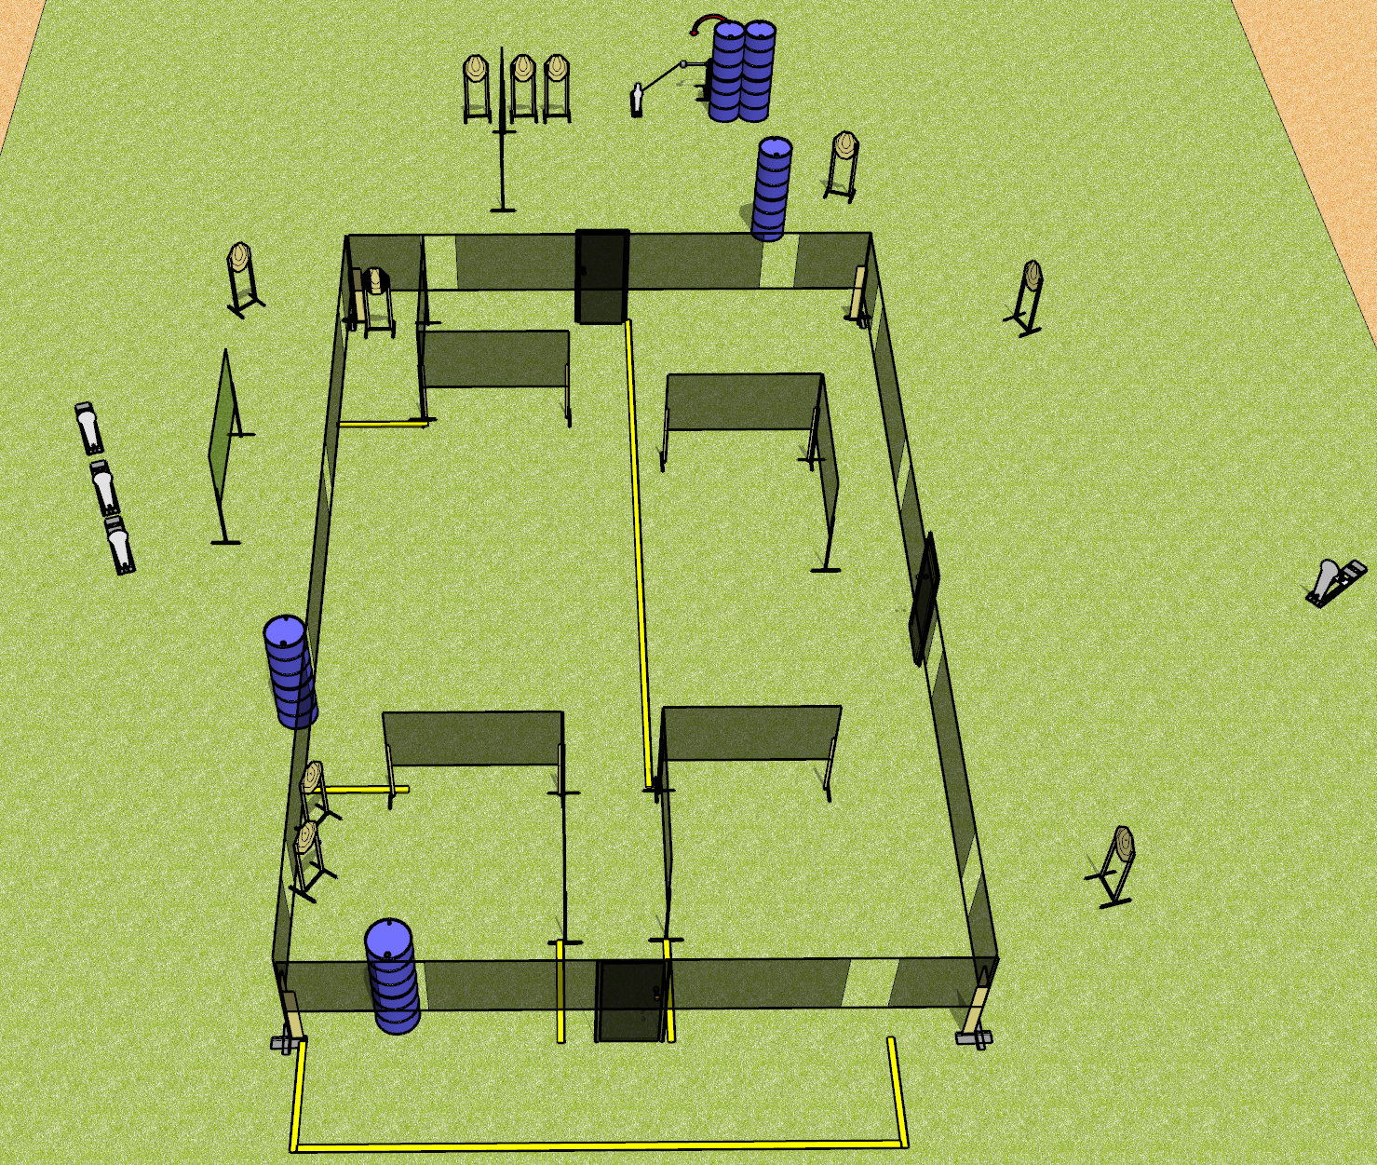
 | Dothan Gun Club – USPSA Match No More House Puns Course Designer : Drew Coleman
Round Count 27 rounds 11 IPSC 4 Colts, 1 mini
Equipment List 2 wall feet Swinger + Activator 1 tux, 10 targets

Slide 8
No More House Puns
Written Stage Briefing
No More House Puns is a 27 round, 135 point, Comstock course of fire. There are 11 IPSC targets and 5 steel. The best 2 hits on cardboard will score and steel must fall to score.
Handgun start position is anywhere inside the shooting area, wrists below belt. Handgun is loaded and holstered.
PCC start position is anywhere inside the shooting area, stock on belt. Loaded carbine is held with both hands, safety on.
On the audible start signal, engage targets as they become available from within the shooting area.

Slide 9
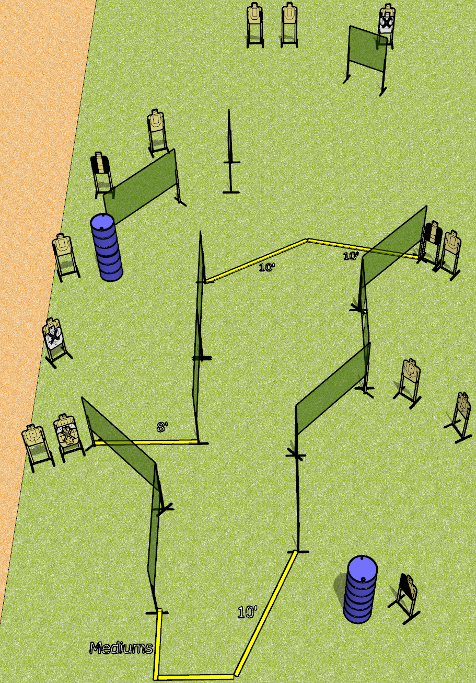
 | Dothan Gun Club – USPSA Match Run and Run Course Designer : Drew Coleman
Round Count 30 rounds 15 USPSA
Equipment List 16 wall feet 2 tux, 1 left diag, 15 targets (12 scoring + 3 NS)

Slide 10
Run and Run
Written Stage Briefing
Run and Run is a 30 round, 150 point, Comstock course of fire. There are 15 USPSA targets. The best 2 hits will score.
Handgun start position is anywhere completely outside the shooting area, wrists below belt. Handgun is loaded and holstered.
PCC start position is anywhere completely outside the shooting area, stock on belt. Loaded carbine is held with both hands, safety on.
On the audible start signal, engage targets as they become available from within the shooting area.

